Slide 1
Numericals (Unit 1)

Slide 2
Q.1. Consider three different raster systems with resolutions of 640 x 480, 1280 x 1024, and 2560 x
2048.
a) What size is frame buffer (in bytes) for each of these systems to store 12 bits per pixel?
Ans. Because eight bits constitute a byte, frame-buffer sizes of the systems are as follows:
640 x 480 x 12 bits / 8 = 450KB
1280 x 1024 x 12 bits / 8 = 1920KB;
2560 x 2048 x 12 bits / 8 = 7680KB;
b) How much storage (in bytes) is required for each system if 24 bits per pixel are to be stored
Similarly, each of the above results is just doubled for 24 (12×2) bits of storage per pixel.

Slide 3
Q.2. Consider two raster systems with the resolutions of 640 x 480 and 1280 x 1024.
(A)How many pixels could be accessed per second in each of these systems by a display controller that refreshes the screen at a rate of 60 frames per second?
Ans. Since 60 frames are refreshed per second and each frame consists of 640 x 480 pixels, the access rate of such a system is (640 x 480) * 60 = 1.8432 x 10⁷ pixels/second.
(B)Likewise, for the 1280 x 1024 system, the access rate is (1280 x 1024) * 60 = 7.86432 x 10⁷ pixels/second.
b) What is the access time per pixel in each system?
Ans. According to the definition of access rate, we know that the access time per pixel should be 1/(access rate). Therefore, the access time is around 54 nanoseconds/pixel for the 640 x 480 system, and the access time is around 12.7 nanoseconds/pixel for the 1280×1024 system.

Slide 4
Q3. Find out the aspect ratio of the raster system using 8 x 10 inches screen and 100 pixel/inch.
Ans. We know that,
Aspect Ratio = Width /Height, So
=(8x100)/(10x100)
=4 : 5

Slide 5
Q.4. How much time is spent scanning across each row of pixels during screen refresh on a raster system with resolution of 1280 X 1024 and a refresh rate of 60 frames per second?
Ans: Here, resolution = 1280 X 1024
That means system contains 1024 scan lines and each scan line contains 1280 pixels
refresh rate = 60 frame/sec.
So, 1 frame takes = 1/60 sec.
Since resolution = 1280 X 1024
1 frame buffer consist of 1024 scan lines
It means then 1024 scan lines takes 1/60 sec
Therefore, 1 scan line takes ,
=1/(60x1024) Sec
=0.058 Sec

Slide 6
Q.5. Suppose RGB raster system is to be designed using on 8 inch X 10 inch screen with a resolution of 100 pixels per inch in each direction. If we want to store 6 bits per pixel in the frame buffer, how much storage (in bytes) do we need for frame buffer?
Ans. Here, resolution = 8 inch X 10 inch
First, we convert it in pixel then
Now resolution = 8 X 100 by 10 X 100 pixel = 800 X 1000 pixel
1 pixel can store 6 bits
So, frame buffer size required = 800 X 100 X 6 bits
=(800x100x6)/8 Bytes
=6 x 10 ⁵ bytes.

Slide 7
Q)Given an image with aspect ratio of 6:2 of an image of pixel resolution of 480000 pixels given the image is an gray scale image.(gray scale image =8bpp)’
Calculate two things:
1)Resolve pixel resolution to calculate the dimensions of image.
2)Calculate the size of the image.

Slide 8
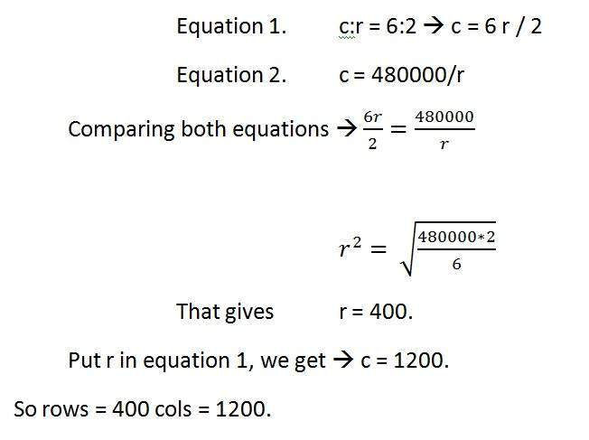
Given:
Aspect ratio: c:r = 6:2
Pixel resolution: c * r = 480000
Bits per pixel: grayscale image = 8bpp
Find:
Number of rows = ?
Number of cols = ?

Slide 9
Solving 2nd part:
Size = rows * cols * bpp
Size of image in bits = 400 * 1200 * 8 = 3840000 bits
Size of image in bytes = 480000 bytes
Size of image in kilo bytes = 48 kb (approx).

